Slide 1
Passive 18x snout on TANDM 90-348 Experimental description
Energetic Neutron Platform Working Group and NIF Radiochemistry Group
Sandra Bogetic, UC Berkeley Nuclear Engineering (PI)
Dawn Shaughnessy: NIF Radiochemistry
Charles Yeamans: NSA shot support
Carlos Esquivel: NSA mechanical design
March 01, 2018

Slide 2
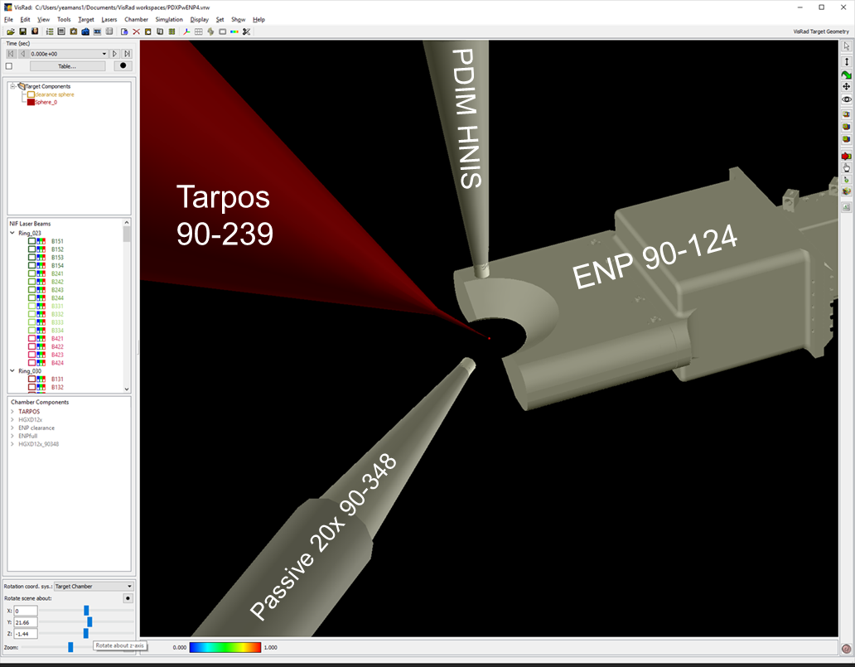
Experimental Configuration Requested N_NED_ExPsh_DT_AAA 3/12/18
positioner | DLP | TCC standoff (cm)
0-0 | HNIS | 10
90-124 | ENP 90-124 | 5.3
90-239 | Direct drive capsule target | 0
90-348 | Passive 18x | 6

Slide 3
Methodology
Design a NIF experiment that can be fielded in ~6 months with available resources and known materials.
Calculate (a MCNP simulation) f4 tallies on the sample volumes:
All cells at zero density
Measurement sample cells at real density, everything else in the universe at zero density
Everything in the universe at real density
Convolve f4 tallies with reaction cross sections.
Calculate (F, h, ε) for all samples and contribution from densities from 2a,b,c.
Make measurements of reaction products generated from a NIF 14 MeV source (IDEP, PDXP, DDEP).
Calculate (F, h, ε) for all samples from data, using a single “absolute yield” measurement as the benchmark.
STASYL unfold of spectrum from measurements: determine sensitivity to converged solution on starting point.

Slide 4
Experimental Configuration Requested N_NED_ExPsh_DT_AAA.
110 cm
tube
41 cm
This experiment populates the nose cap, filter basket, and kinematic base with activation measurement samples.
7 cm
Nose cap

Slide 5
Expected signal levels
location | Product nucleus | Standoff (cm) to center | P_{rx} (per g target) | p_{rx}/Ω (per g target) | Sample mass (approx. g) | Product nuclei/10¹⁵ source neutrons | Flux (n/cm²)
pinhole | In115m | 6.47 | 6.30E-07 | 2.05E-04 | 1.2 | 7.56E+08 | 6.7E+12
pinhole | Zr89 | 6.85 | 3.45E-06 | 0.0158 | 1.03 | 3.56E+09 | 5.9E+12
pinhole | Na24 | 6.66 | 4.88E-06 | 0.0211 | 0.3 | 1.46E+09 | 6.3E+12
pinhole | Au196 | 6.66 | 1.17E-05 | 0.0506 | 0.05 | 5.84E+08 | 6.3E+12
basket | In115m | 47.015 | 1.19E-08 | 6.54E-05 | 1.3 | 1.55E+07 | 1.3E+11
basket | Zr89 | 47.035 | 7.33E-08 | 0.0051 | 1.4 | 1.03E+08 | 1.3E+11
basket | Na24 | 47.025 | 9.79E-08 | 0.0067 | 0.5 | 4.89E+07 | 1.3E+11
basket | Au196 | 47.005 | 2.34E-07 | 0.0161 | 0.1 | 2.34E+07 | 1.3E+11
kbase | In115m | 118.673 | 1.87E-09 | 1.69E-05 | 13 | 2.43E+07 | 2.0E+10
kbase | Zr89 | 119.173 | 1.14E-08 | 0.0013 | 14 | 1.60E+08 | 2.0E+10
kbase | Na24 | 119.173 | 1.52E-08 | 0.0017 | 5 | 7.62E+07 | 2.0E+10
kbase | Au196 | 118.173 | 3.71E-08 | 0.0042 | 1 | 3.71E+07 | 2.0E+10
In-115m was 4.4e15 14 MeV eq. (1/1.18 yield fraction)
Zr-89 was 3.17e15 14 MeV eq.

Slide 6
Summary Table of neutron transport efficiencies
location | isotope | mass (g) | A0 (Bq) | N0 (nuclei) | N0/g | p_{rx} N0/n/g | design p_{rx} N0/n/g | ε meas/design | ε meas/massless | ε meas/sample only | ε meas/full density
pinhole | Au196g | 0.148 | 6.97E+03 | 5.37E+09 | 3.63E+10 | 9.81E-06 | 1.17E-05 | 0.840
basket | Au196g | 0.9393 | 9.47E+02 | 7.29E+08 | 7.76E+08 | 2.10E-07 | 2.34E-07 | 0.895
kinematic base | Au196g | 3.733 | 5.74E+02 | 4.42E+08 | 1.18E+08 | 3.20E-08 | 3.71E-08 | 0.863
pinhole | Au196m | 0.148 | 6.93E+03 | 3.45E+08 | 2.33E+09 | 6.31E-07
basket | Au196m | 0.9393 | 9.25E+02 | 4.61E+07 | 4.91E+07 | 1.33E-08
kinematic base | Au196m | 3.733 | 5.86E+02 | 2.92E+07 | 7.82E+06 | 2.11E-09
pinhole | Au198 | 0.148 | 1.07E+02 | 3.58E+07 | 2.42E+08 | 6.54E-08
basket | Au198 | 0.9393 | 2.00E+02 | 6.72E+07 | 7.15E+07 | 1.93E-08
kinematic base | Au198 | 3.733 | 6.63E+02 | 2.23E+08 | 5.97E+07 | 1.61E-08
pinhole | In113m | 1.182 | 1.43E+04 | 1.23E+08 | 1.04E+08 | 2.81E-08
basket | In113m | 0.4189 | 1.15E+02 | 9.94E+05 | 2.37E+06 | 6.41E-10
kinematic base | In113m | 14.35 | 6.22E+02 | 5.36E+06 | 3.73E+05 | 1.01E-10
pinhole | In114m | 1.182 | 7.41E+03 | 4.61E+10 | 3.90E+10 | 1.06E-05
basket | In114m | 0.4189 | 5.94E+01 | 3.70E+08 | 8.83E+08 | 2.39E-07
kinematic base | In114m | 14.35 | 2.91E+02 | 1.81E+09 | 1.26E+08 | 3.41E-08
pinhole | In115m | 1.182 | 1.23E+05 | 2.87E+09 | 2.43E+09 | 6.57E-07 | 6.30E-07 | 1.043
basket | In115m | 0.4189 | 9.30E+02 | 2.17E+07 | 5.18E+07 | 1.40E-08 | 1.19E-08 | 1.173
kinematic base | In115m | 14.35 | 5.57E+03 | 1.30E+08 | 9.04E+06 | 2.44E-09 | 1.87E-09 | 1.306
pinhole | In116m | 1.182 | 1.53E+05 | 7.18E+08 | 6.07E+08 | 1.64E-07
basket | In116m | 0.4189 | 1.69E+04 | 7.91E+07 | 1.89E+08 | 5.11E-08
kinematic base | In116m | 14.35 | 2.12E+05 | 9.97E+08 | 6.95E+07 | 1.88E-08
pinhole | Zr89 | 1.008 | 2.77E+04 | 1.13E+10 | 1.12E+10 | 3.03E-06 | 3.45E-06 | 0.876
basket | Zr89 | 0.2626 | 1.76E+02 | 7.15E+07 | 2.72E+08 | 7.36E-08 | 7.33E-08 | 1.005
kinematic base | Zr89 | 12.555 | 1.13E+03 | 4.61E+08 | 3.67E+07 | 9.92E-09 | 1.14E-08 | 0.869

Slide 8
Intro to NIF snout nomenclature
Assemblies
Attribute | Nose Cap | Nose Cone | Kinematic Base
Name | FILTER, 6.35ID, In/Zr, Au-Au TOAD, DIXI | FILTER, INLINE, Zr-702/Al/In/Au TOAD | FILTER, Zr-702/Al/In/Au SRC, SHIELDED
Part Number | AAA14-113745 | 1003599727 | 1003599958
Filter 1 | FILTER, 6.35ID, SOLID, 1mm In, TAB-02 | One 125um 43 dia Polyimide Filter | FILTER, Zr-702/Al/In/Au SRC
Filter 1 P/N | AAA14-112922-02 | AAA10-107867-125 | 1003599929
Filter 2 | FILTER, TOAD, 6.35ID, AU-AU, TAB-02 | FILTER, 43OD, Zr-702/Al/In/Au TOAD | NONE
Filter 2 P/N | AAA14-112928-02 | 1003599822 | N/A
Filter 3 | FILTER, 6.35ID, SOLID, 1mm Zr, TAB-01 | NONE | NONE
Filter 3 P/N | AAA14-112922-01 | N/A | N/A
Filter 4 | NONE | NONE | NONE
Nose cone
(the “assembly” includes the cap)
Nose cap

Slide 9
Intro to NIF snout nomenclature
Kinematic base
tube
Filter Basket
Nose cone
(the “assembly” includes the cap)
Nose cap

Slide 10
drawing | description | Level (from snout top)
1003598741 | snout | 0
1003599724 | Snout layout | 0
1003599958 | K-base assembly | -1
1003599929 | K-base activation assembly | -2
1003599727 | Filter basket assembly | -1
1003599822 | Filter basket activation assembly | -2

Slide 11
Pinhole geometry
Item | Standoff (mm) | Thickness (mm) | Flux on 3e15 shot
TCC | 0 |  | 3.00E+15
cap front | 60.43 |  | 6.54E+12
cap rear | 62.97 | 2.54 | 6.02E+12
wavy washer |  | 1.23
In (front) | 64.2 | 1 | 5.79E+12
Treefrog (front) | 65.2 | 2.8 | 5.62E+12
Zr (front) | 68 | 1 | 5.16E+12
Zr rear | 69 |  | 5.01E+12
5.0 x 10¹² n/cm²
6.0 x 10¹² n/cm²

Slide 12
Passive 18x snout configuration nose cap filtering AAA14-113745
1 | N5210-25795 | Wavy washer | SST 17-7PH | 5
1 | AAA14-112928-02 | Filter, TOAD, 6.35 ID, Au-Au, tab-02 | n/a | 4
1 | AAA14-112922-02 | Filter, 6.35 ID, solid, 1 mm In, tab-02 | Indium | 3
1 | AAA14-112922-01 | Filter, 6.35 ID, solid, 1 mm Zr, tab-01 | Zirconium-702 | 2
1 | AAA09-103686-01 | Pinhole spacer, tab-01 | SST 304 | 1
QTY REQD | IDENTIFYING NUMBER | DESCRIPTION | MATERIAL SPECIFICATION | ITEM NUMBER

Slide 13
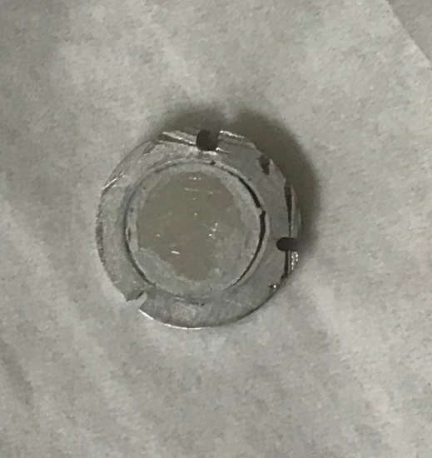
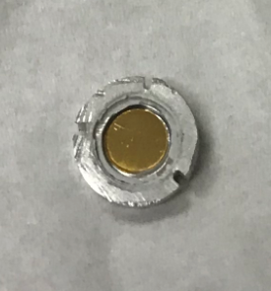
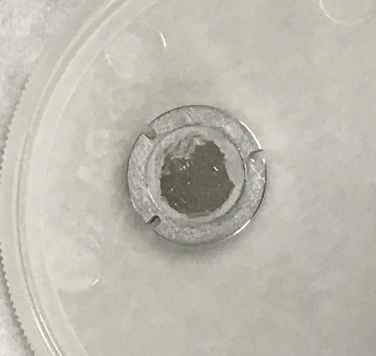
Pinhole Treefrog sample postshot
The gold sample saw a 14 MeV neutron flux of 6.2 x 10¹² n/cm² on shot N180311-002.

Slide 14
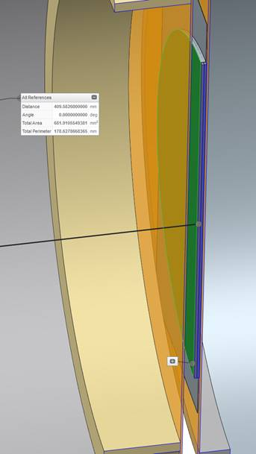
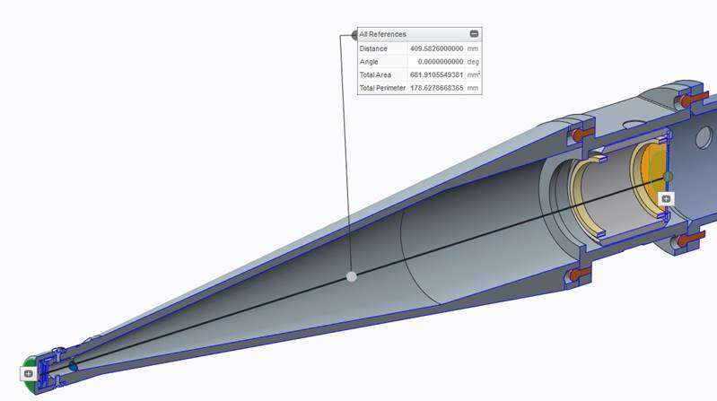
Filter basket sample standoff
470.01 mm from TCC to the front surface of the filter basket stack

Slide 15
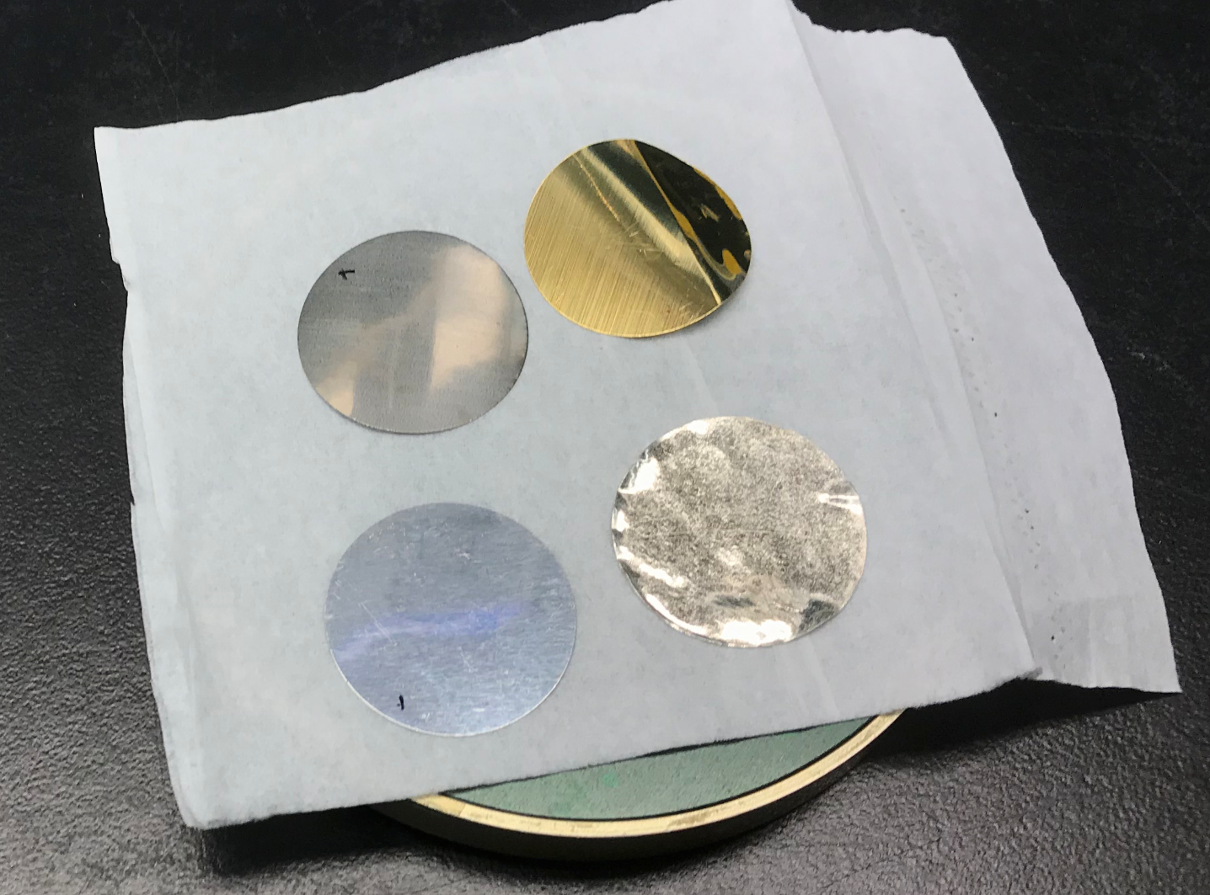
Filter basket samples after retrieval.
Au
Zr
In
Al
The basket samples saw a 14 MeV neutron flux of 1.3 x 10¹¹ n/cm² on shot N180311-002.

Slide 16
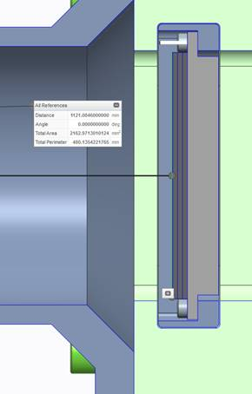
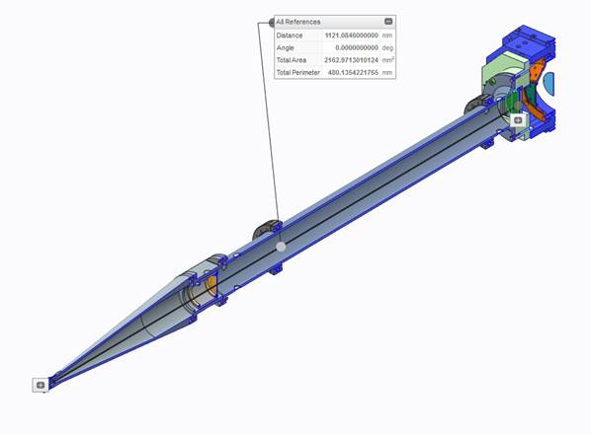
Kinematic base sample standoff
1181.23 mm from TCC to the front surface of the kbase stack.
The kinematic base samples saw a 14 MeV neutron flux of 2.0 x 10¹⁰ n/cm² on shot N180311-002.

Slide 17
Passive 18x snout configuration nose cone (spool) filtering
1 | AAA14-106866-43 | Toad inserts, tabulated (0.1 mm, 1”) | Zirconium-702 | 8
1 | AAA14-106866-xx | Toad inserts, tabulated (0.1 mm, 1”) | Aluminum | 7
1 | AAA14-106866-27 | Toad inserts, tabulated (0.1 mm, 1”) | Indium | 6
1 | AAA14-106866-17 | Toad inserts, tabulated (0.1 mm, 1”) | gold | 5
A/R | 1001225642 | Tape, NIF vac approved | Kapton | 4
2 | AAA10-107867-125 | filter, polyimide, 43 dia 125 um thk | See table | 3
1 | AAA10-107866-02 | Tab -02 1.0 thk spacer, inline basket | Al 6061-T6 | 2
1 | AAA10-102783 | Cassette assy, filter | n/a | 1
QTY REQD | IDENTIFYING NUMBER | DESCRIPTION | MATERIAL SPECIFICATION | ITEM NUMBER

Slide 18
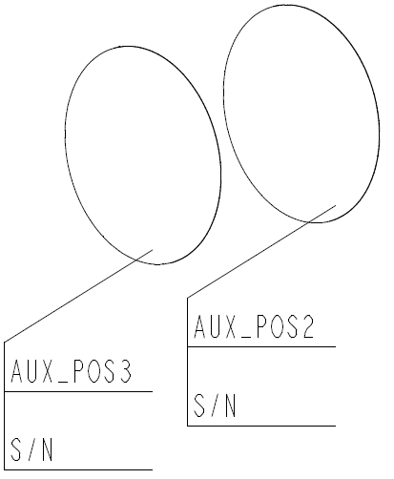
Passive 18x snout configuration Kinematic base filtering
1 | AAA10-107885 | Filter plate, 6.25 thk | Al 6-61-T6 | 6
1 | AAA10-111417-14 | SRC witness sample plate, 1 mm Zr | Zirconium-702 | 5
1 | AAA09-114578-05 | Activation sample, 1 mm thk Al | Aluminum | 4
1 | AAA09-114578-01 | Activation sample, 1 mm thk In | Indium | 3
1 | AAA10-111417-14 | SRC witness sample plate, 0.1 mm Au | gold | 2
A/R | 1001225642 | Tape, NIF vac approved | Kapton | 1
QTY REQD | IDENTIFYING NUMBER | DESCRIPTION | MATERIAL SPECIFICATION | ITEM NUMBER
Al
Zr
In
Au
TCC
4
3
2
1

